Slide 1
2018 Chess statistics
Andrey Puzanov

Slide 2
Introduction
2018 Chess statistics
Played 1170 chess games last year at chess.com
Want to collect the data from the website and form a table with summary statistics
Then visualise it using Matplotlib and Seaborn libraries
Finally, create a model that can predict results of my future matches based on that statistics

Slide 3
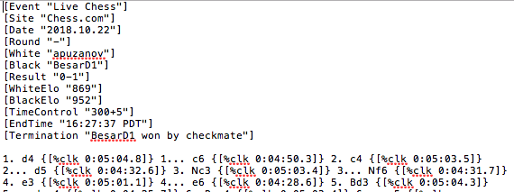
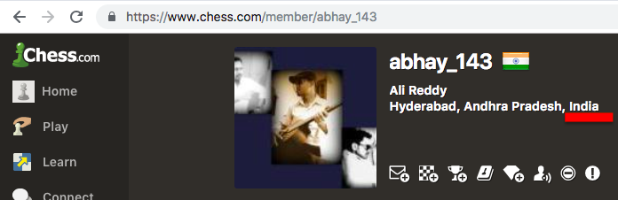
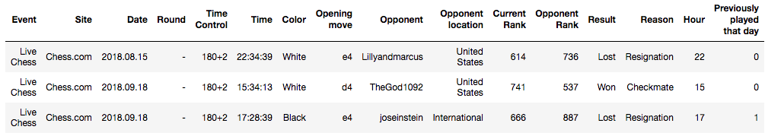
Collecting the data
2018 Chess statistics
.pgn file
urllib.request
read_data.py script can be found in the root folder for this project

Slide 4
Visualising the data
2018 Chess statistics
Plots:
Total games played, won, lost, made a draw; my rank growth
Results vs. rank of my opponent, weather I was playing black or white, time of the day
Results vs. first move my opponent made when playing white; first move I made when playing white
Interactive World map with my record against opponents from each country
2018_chess_stats.ipynb can be found in the root folder for this project

Slide 5
Predictions
2018 Chess statistics
Please see corresponding .ipynb file for the experiment using each of the following methods:
Logistic Regression
K-NN
Kernel SVM
ANN using TensorFlow library
ANN using Keras

Slide 6
Conclusion
2018 Chess statistics
Turned out that the best results were shown by simple Logistic Regression. However, it can barely beat just the “Result vs. Opponent Rank” graph
Almost no correlation with columns other then Color and Opponent Rank
Knowing the first move the opponent is going to make can increase the accuracy by 3%

Slide 7
2018 Chess statistics
Thank you !

